Slide 1
Face Detection
Dec. 12th 2017
Wenhao Song
Jian Yang
Siyan Lin

Slide 2
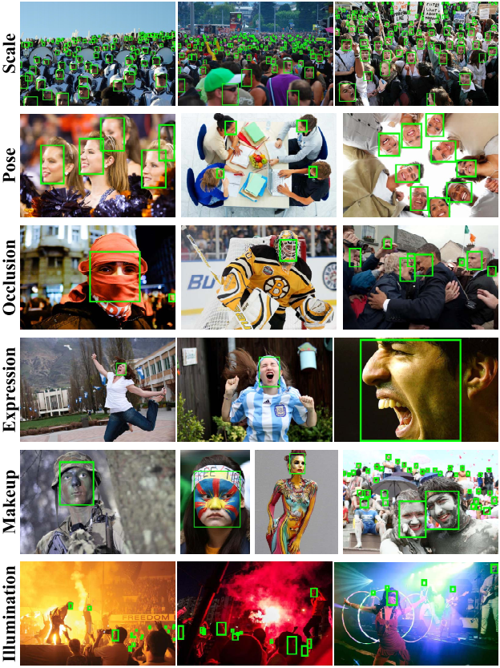
Motivation and Challenges
Problem
Detect various faces from background
Motivation
Automatic camera focus
Easier photo tagging
First step in any face recognition algorithm
Challenges
Different scales
Different poses (orientation)
Occlusion and makeup
Different expressions
Different illumination
Efficiency

Slide 3
Baseline and Preliminary Results
Machine Learning based Sliding window approach
Step 1: Training SVM classifier on face-only dataset
Step 2: Generating overlapping windows as proposals, and extract HOG features
Step 3: Use trained SVM model to predict each window→ face yes/no ?
Training Dataset:
Face data: Yale face set, ATT face set,
Background: Databases for Face Detection and Pose Estimation http://robotics.csie.ncku.edu.tw/Databases/FaceDetect_PoseEstimate.html

Slide 4
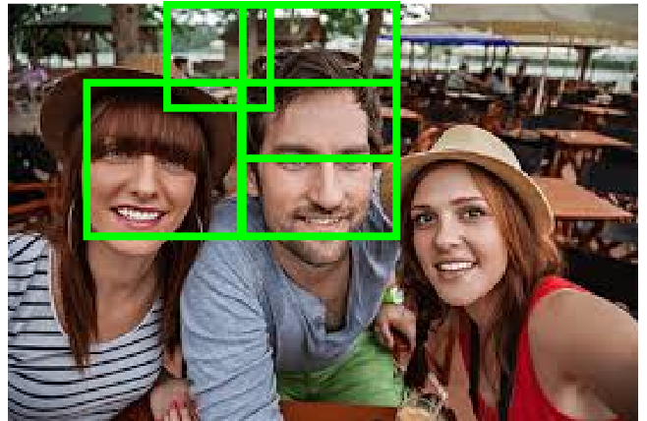
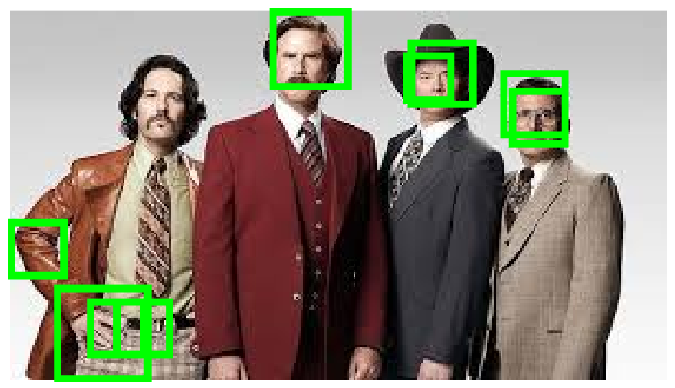
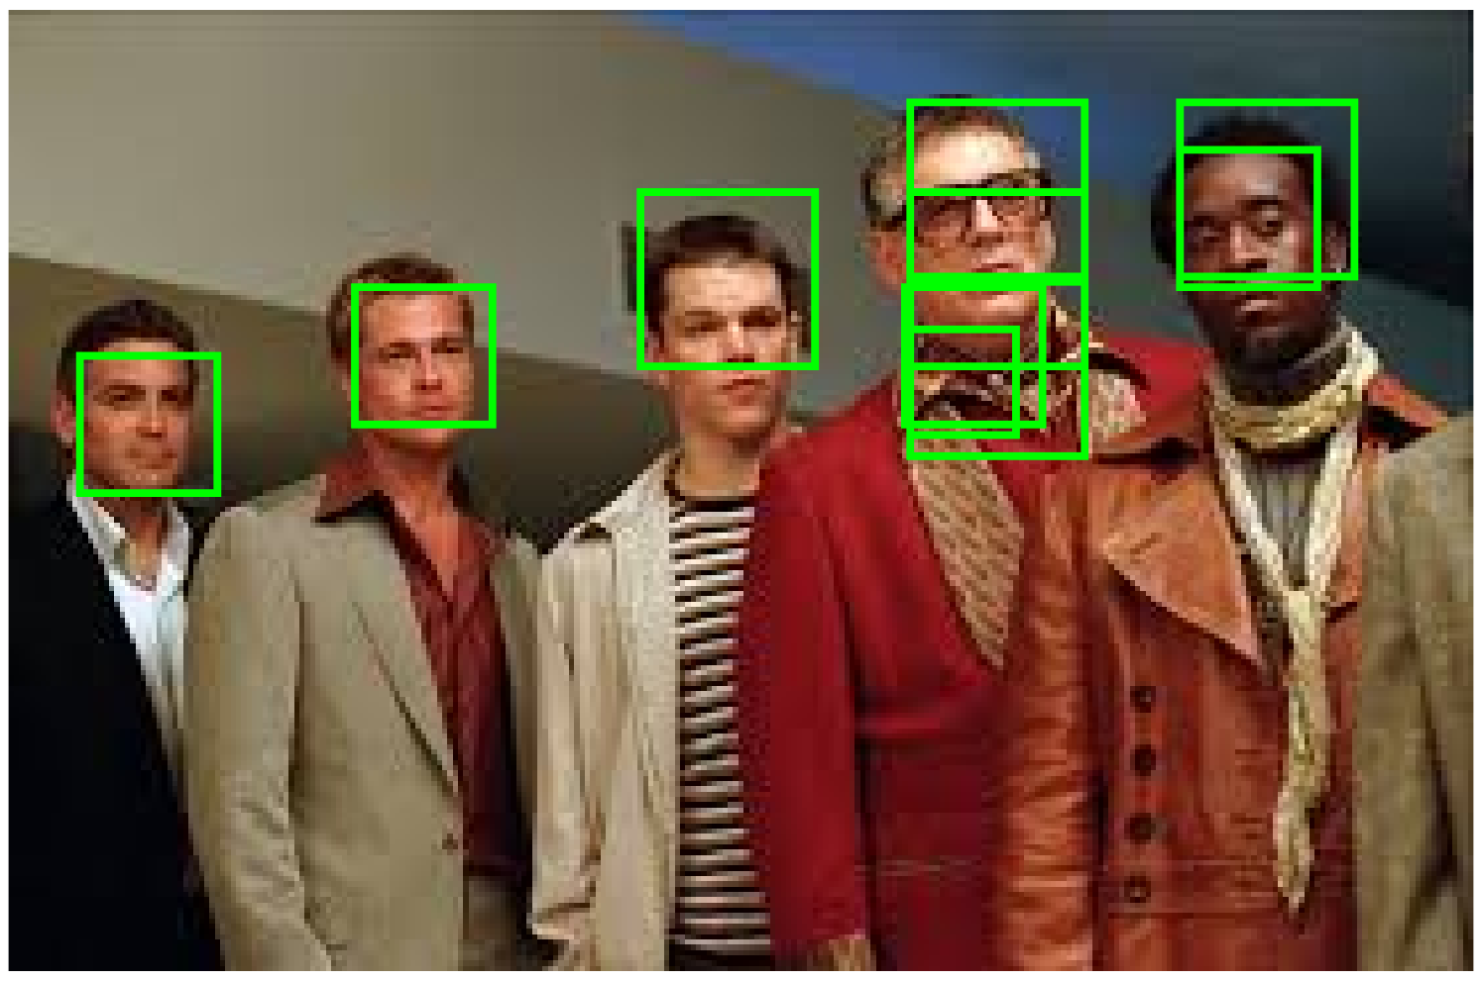
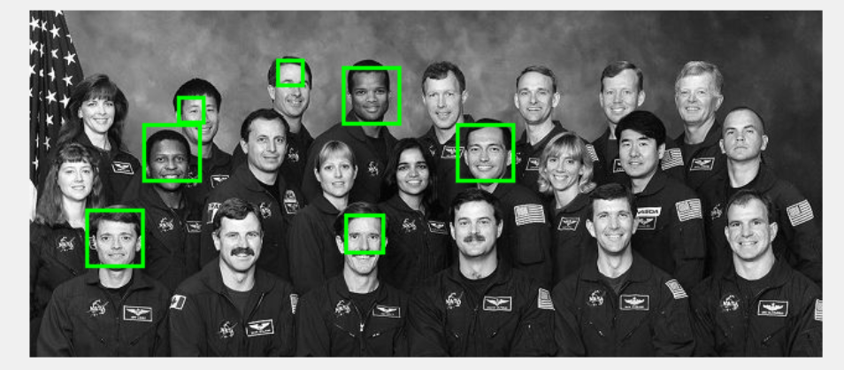
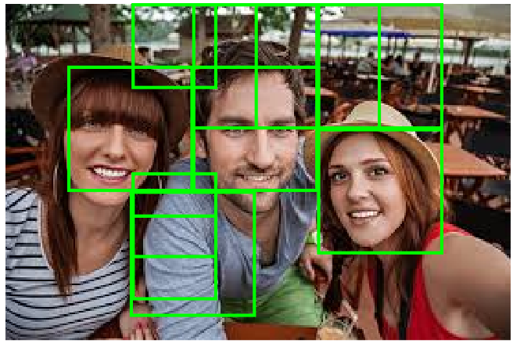
Evaluation
Same as PASCAL VOC dataset
If the ratio of the intersection of a detected region with an annotated face region is greater than 0.5, a score of 1 is assigned to the detected region, and 0 otherwise.
A Precision-Recall curve will be generated.

Slide 5
Plan Next
Keep improving our baseline approach through training larger training and testing dataset, extracting various features (HOG, v-g, gabor, LBP). Obtain detailed precision and recall accuracy.
Build a rCNN model, use SVM as the last layer.
Explore different region proposal.
Explore Detection without Proposals.

